Slide 1
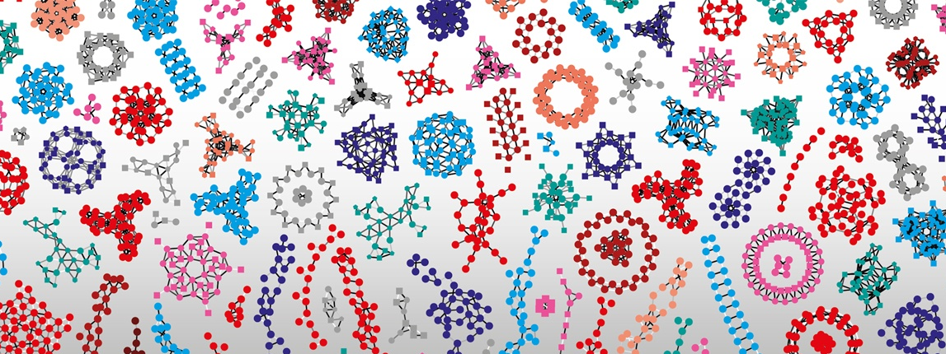


Fun with RDF
Vital-IT internal group meeting
5th of April 2022
Marco Pagni

Slide 2
A SPARQL tutorial (step by step)
https://docs.stardog.com/tutorials/learn-sparql
Stadog is a concurrent of GraphDB which offer a nice tutorial
The data for this tutorial have been preloaded in GraphDB in the “Tutorial” repository

Slide 3
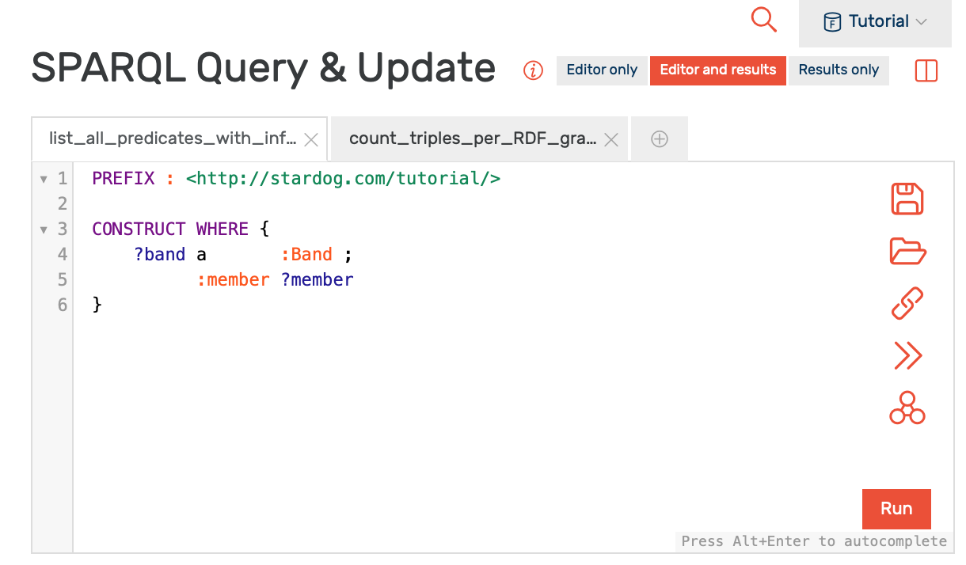
Most queries queries from the tutorial can be executed in GraphDB…
… AFTER adding the following prefix definition at the beginning of the query:
PREFIX : <http://stardog.com/tutorial/>
here

Slide 4
Nota Bene:
Most queries should work nicely in GraphDB
The syntax paths … via is a stardog extension will not work. It is a stardog extension, that also exist in GraphDB under a different syntax
Queries with INSERT and/or DELETE cannot work in a read-only repository

Slide 5
Adducts story
Adducts are reported in feature annotations. For example: do GNPS and SIRIUS annotate with the same adduct?
Answer 1: Not always
Answer 2: Not with the same syntax

Slide 6
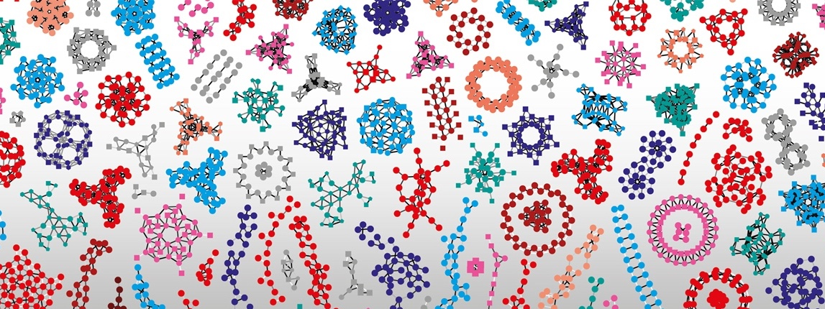
Thank you

